Slide 1
Recovery-Oriented Methadone Maintenance
William L. White, MA
Senior Research Consultant
Chestnut Health Systems
bwhite@chestnut.org
“I am not my disease, and I am not my medication.” --Methadone Patient, 2009

Slide 2
Dedication: Dr. Ed Senay & Lisa Mojer-Torres, J.D.

Slide 3
Presentation Goals
Describe changes in recovery-oriented practices within the evolution of methadone maintenance treatment (MMT)
Identify at least 3 concerns that led to call for increased recovery orientation of MMT
Define Recovery-oriented MMT (and what it is NOT)
List at least 5 service ingredients that distinguish ROMM
Discuss strategies to reduce social and professional stigma attached to MMT and broader arena of medication-assisted treatment and recovery

Slide 4
A Note on Note-taking & Resources
The information reviewed in this webinar is detailed with full citations in the 2010 White & Mojer-Torres monograph, Recovery-oriented Methadone Maintenance, and the other publications noted on the last slides. All are available for free download at www.williamwhitepapers.com
The slide of this presentation will be posted for download.

Slide 5
The Historical Context for the Development of MMT
Technology
Isolation of Morphine
Drug Promotion
Patent Medicine Industry
Specialized Treatment
Homes, Asylums, Institutes
Hypodermic Syringe
Fraudulent Cures

Slide 6
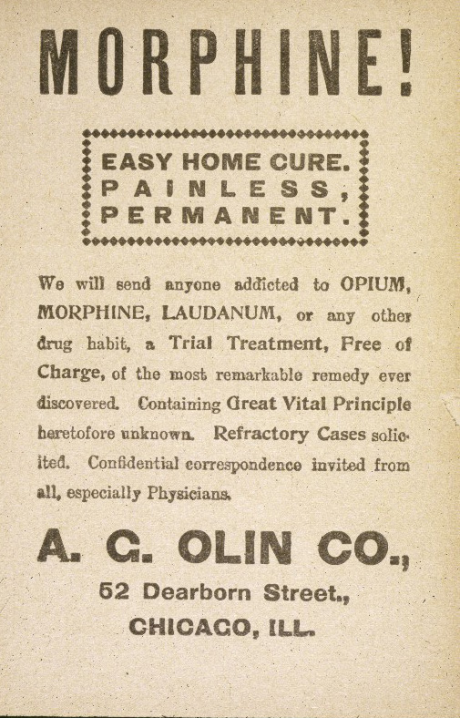
Iatrogenesis: Harm in the Name of Help

Slide 7
The Historical Context for the Development of MMT
Collapse
Of 19th Century Tx
Harrison Act
Narcotics Farms
High Post-Tx Relapse Rates
Mid-20th Century rise in Heroin Addiction
Moral Panic
Vietnam
1919-1924 Clinics
Webb V. United States
Porter Act (1929)
Lexington, KY (1935)
Fort Worth, Tx (1938)
Juvenile Narcotic Addiction & Riverside Hospital (52-61)
Experimental, e.g., Bromide Therapy

Slide 8
Therapeutic Pessimism Sparks Search for New Tx Approaches
Psychoanalysis and Psychotherapy
Serum Therapy, ECT, Psychosurgery, LSD, ECT, Aversion Therapy,
Grassroots community counseling clinics (1950s)
Mutual Aid via Addicts Anonymous (1947) & Narcotics Anonymous (1953; near death in 1959; limited growth)
Therapeutic Communities (Synanon, 1958)
Civil Commitment
Narcotic Antagonists (e.g., naloxone, naltrexone)
Methadone Maintenance

Slide 9
MMT Pioneers
Dr. Vince Dole
Dr. Marie Nyswander
Dr. Mary Jeanne Kreek
MMT as a Patient-centered medical treatment
Role of Psychosocial Support
Dole/Nyswander AA/NA involvement

Slide 10
Recovery Orientation of Early MMT
Rapid Access to Tx
Emphasis on Therapeutic Alliance
Blockade Doses (80-120 mgd)
No limits on duration of MMT
Programs for special populations
Recovering staff as role models

Slide 11
Regulation & Mass Expansion
Federal and widely varying state and local regulation of MMT
Rapid Growth under Nixon Administration
22 patients in 1965
400 patients in 1968
36,000 patients in NYC in 1972
80,00 patients in US in 1976
Present
260,000 MMT patients in 2008 (in 1,132 certified OTPs)
Estimates of persons addicted to opiates in US range between 750,000-1,000,000

Slide 12
Regulation & Mass Expansion
Decreased recovery orientation via
Shift in focus from personal recovery to reduction of social costs, e.g., crime and infectious disease
Widely varying quality of MMT clinics
Reduction of average methadone doses to sub-therapeutic levels
Decreased duration of MMT with increased pressure to end medication maintenance
Erosion of ancillary services, particularly in 1980s
Preoccupation with mechanics of dosing rather than larger process of recovery

Slide 13
Early Methadone Critics Alleged:
Substitutes one addictive drug for another
Conveys permissiveness towards drug use
Fails to address characterological or social roots of heroin addiction
Impairs patients cognitively, emotionally, behaviorally
Is a tool of racial oppression
Is financially exploitive
Public/professional stigma left MMT & patients in a cultural limbo

Slide 14
Revitalization of MMT (1990-present)
Reaffirmation of MMT effectiveness by leading scientific, professional and governmental bodies
Advocacy efforts of MMT patients (e.g., AFIRM, NAMA-R)
Expansion of pharmacotherapy choice, e.g., buprenorphine
Expansion of MMT in private sector following erosion of public funding
Focus on elevating quality of MMT
Accreditation of Opioid Treatment Programs

Slide 15
Setting the Stage for ROMM
Understanding Opioid Addiction as a Chronic Disorder
Emergence of Recovery as New Organizing Paradigm in Addictions Field
Efforts to Extend Acute & Palliative Models of Care to Models of Assertive Recovery Management (RM) & Recovery-Oriented Systems of Care (ROSC)
Questions of Implications of RM & ROSC to Medication-Assisted Treatment (MAT)

Slide 16
Emerging Recovery Definition
Sobriety
(abstinence / remission)
Global Health
Citizenship

Slide 17
Limbo Status of the MM Patient
Positing recovery as a journey of self-transformation, the methadone patient subsists in undetermined space—a hinterland beyond the clearly demarcated identity fissures of “addict” or “recovering addict.” In the absence of a proactive recovery culture, the methadone maintenance patient becomes tied to an archetypal “spoiled identity” to be managed and governed rather than retrieved, nurtured and healed (Bamber, 2010).

Slide 18
Recovery & Medication Status BFI Consensus Statement
“…formerly opioid-dependent individuals who take naltrexone, buprenorphine, or methadone as prescribed and are abstinent from alcohol and all other nonprescribed drugs would meet this definition of sobriety” (Journal of Substance Abuse Treatment, 2007)

Slide 19
Growing Professional Consensus
For MAT patients who achieve recovery via these three dimensions, continued participation in medication maintenance or eventual tapering and recovery without medication support represent varieties of recovery experience and matters of personal choice, not the boundary of passage from the status of addiction to the status of recovery. (White, 2012, Journal of Addictive Diseases)

Slide 20
This perspective requires:
Distinguishing
Physical Dependence
Addiction
Distinguishing
Drugs that compromise recovery status
Medications that may enhance recovery stability
Craving, obsession, compulsion
Tolerance, Withdrawal

Slide 21
This Perspective Requires Challenging Methadone Myths, such as
1.
Methadone is “addicting.”
2.
Methadone is intoxicating and impairing
Stabilized patients do not experience intoxication from optimal doses of methadone nor are they impaired by the medication
3.
Those on lower doses of methadone and shorter duration of methadone have better long-term recovery prospects
Studies suggest the exact opposite
Stabilized MM patients do not meet criteria for DSM-IV opioid dependence

Slide 22
ROMM Defined
ROMM is an approach to treatment of opioid addiction that combines medication and a sustained menu of professional and peer-based recovery support services to assist patients and families in initiating and maintaining long-term recovery.

Slide 23
Problems of MMT addressed by ROMM include:
Low rate of attraction (6-15 years before 1st admission; 22 years prior to achieving recovery stability)
Problems of access (25-50% of persons on waiting list drop out before admission)
Subclinical dosing and dose manipulations or administrative discharge for rule infractions
Continued drug use while in MMT related to withdrawal distress (often linked to subtherapeutic doses of methadone), dysphoric emotional states, pleasure-seeking, and impulsive responses to social opportunities to use (Best et al., 1999).

Slide 24
Problems of MMT addressed by ROMM include:
Low rate of sustained engagement (24% drop-out in first 60 days; 60.2% drop-out by one year)
High rate of drop-out/discharge without planned tapering (11% as planned; 45% drop out; 17% transferred; 13% AD; 15% other)
High rate of post-discharge relapse (50%+ in first year after discharge; most in first 30 days) and high mortality risk (8-20 times greater than patients in treatment)
Low linkage to indigenous recovery communities or alternative recovery support institutions
Role of self-stigma and professional/social stigma attached to MMT as obstacle to community reintegration

Slide 25
ROMM does NOT:
Raise the bar of admission to MMT
Set arbitrary limits on dosage or duration of MMT
Impose pressure for patients to end MMT
Force counseling or peer support services on patients who do not want or would not benefit from them
Extrude patients who do not adopt the goal of full recovery
Impose remission/recovery criteria on MMT patients different that those applied to other patients with SUDs.

Slide 26
ROMM Does Seek To:
Attract people at earlier stages of problem development
-Assertive community education & outreach
Ensure rapid access to MMT / Resolve obstacles to Tx
-Streamlined intake and assertive waiting-list management
Assure safe, individualized, optimum dose stabilization
-Close medical monitoring during induction; individualized dosing philosophy, signs of clinical deterioration prompt rapid dose re-evaluation & need for ancillary services
Engage and retain individuals/families in a sustained recovery support process

Slide 27
ROMM Does Seek To:
Utilize assessment processes that are global, family-centered, strengths-based and continual
-Examples, ASI, GAIN
Transition each patient from a professionally-directed treatment plan to a patient-directed recovery plan
-Former aimed at remission (-); latter aimed at recovery (+)
Expand the service team
-e.g., primary care physicians, family therapists, peer specialists
Shift the service relationship from a directive expert model to a recovery partnership/consultation model

Slide 28
ROMM Does Seek To:
Assure minimum/optimum duration of MMT
-Minimum 1-2 years (Patients who taper after 1-2 years have better long- term post-Tx outcomes than those ending treatment before 1 year)
-Option of prolonged, if not lifelong, maintenance
-Focus is on recovery not duration of medication support
Expand the service menu & imbed services in vibrant culture of recovery
-Expanded menu of ancillary services
-C of A to C of R; RC infused treatment milieu
-Recovery is contagious
Extend delivery of recovery support services into the community
-e.g., C0-location; delivery of recovery support services outside the clinic

Slide 29
ROMM Does Seek To:
Link patients/families to recovery community support resources
-Assertive versus passive linkage procedures
Provide post-treatment monitoring, support and, if and when needed, early re-intervention.
-Recovery checkups & re-engagement
Evaluate MMT using proximal and distal indicators of long-term personal and family recovery
-Moving beyond short-term HR outcomes (mortality, crime, disease) to long-term measures of global health, quality of life and community contribution
Conduct anti-stigma campaigns aimed at patients, families, staff, allied professionals and the community.

Slide 30
Strategies to Address Professional/Social Stigma
1.
Protest
2.
Education
3.
Contact

Slide 31
Missing Voices in MMT Discussions
Patients and Families
Need for vanguard of individuals/families to put faces and voices on medication-assisted recovery
There are signs that this vanguard is emerging
That vanguard needs to be engaged in RM/ROSC/ROMM design and evaluation efforts

Slide 32
References
White, W. & Torres, L. (2010). Recovery-oriented methadone maintenance. Chicago, IL: Great Lakes Addiction Technology Transfer Center, Philadelphia Department of Behavioral Health and Mental Retardation Services and Northeast Addiction Technology Transfer Center.
White, W. (2011). Narcotics Anonymous and the pharmacotherapeutic treatment of opioid addiction. Chicago, IL: Great Lakes Addiction Technology Transfer Center and the Philadelphia Department of Behavioral Health & Developmental disAbilities Services.

Slide 33
References
White W, Parrino M, Ginter W. A dialogue on the psychopharmacology in behavioral healthcare: the acceptance of medication-assisted treatment in addictions. Commissioned briefing paper for: SAMHSA Dialogue on Psychopharmacology in Behavioral Healthcare; 2011 Oct 11-12.
Betty Ford Institute Consensus Panel. (2007) What is recovery? A working definition from the Betty Ford Institute. J Subst Abuse Treat 33:221-228.

Slide 34
References
White, W. (2012). Recovery orientation in methadone maintenance: A definitional statement. Posted at www.williamwhitepapers.com
White, W. (2012) Medication-assisted recovery from opioid addiction: Historical and contemporary perspectives Journal of Addictive Diseases,.31(3), 199-206.
All References available for free download at www.williamwhitepapers.com

